Slide 1
Sugar

Slide 2
What It Is
Energy for all living things
In its simplest form, glucose, sugar is the building blocks for all carbohydrates and provides the sugary flavor in highly refined sweeteners like corn syrup
Glucose + Glucose = Maltose (used for fermentation of beer)
Glucose + Galactose = Lactose (milk sugar)
Glucose + Fructose = Sucrose (sugar refined from cane sugar and sugar beets)

Slide 3
History
The major source of sugar is sugar cane
Extracting juices from sugar cane and then boiling it into a dark syrup (molasses) and a mass of crystal (sugar) was being practiced in India before 550 BCE
By 100 BCE, sugar was used in medicinal products
After the 11th century, sugar trade spread throughout Europe where it was used mainly in candying flowers and fruits and sugaring medicine to make it more palatable
15th Century – art of confectionary is used world wide

Slide 4
History
18th Century – sugar becomes widely available from sugar plantations in the West Indies
In England, sugar consumption rose from 4lbs in 1700 to 12 lbs in 1780
An estimated 13 million enslaved Africans are working in the sugar industry
1800 – Every European country had outlawed slavery in its colonies and the West Indies sugar industry collapses
1840 – flourishing sugar-beet industry in Northern Europe
Andreas Marggraf develops a method for extracting sugar from white beets (sugar beets)
Today, 30% of the sugar comes from sugar beets and 65% come from sugar cane

Slide 5
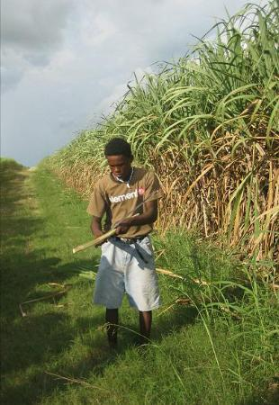
Sugar Processing
Sugar cane is very perishable and must be processed immediately after harvest so it is produced in two stages:
First, it is boiled, crushed and crystallized into unrefined raw sugar near the cane plantation
Second, it is shipped to factories for refining

Slide 6
Refinement
For Raw Sugar
Milling
the beet or cane is washed, shredded and rolled to extract juice
Clarification
The juice is mixed with calcium hydroxide to raise its pH to 7
This keeps acid in the juice from breaking the sucrose into glucose and fructose molecules
It is heated gently to coagulate the proteins, which are removed
Concentration
The clarified juice is heated gently in shallow pans until the sucrose concentration in the syrup is around 60%
It is placed in a vacuum chamber to remove 10% more water

Slide 7
Refinement
For Raw Sugar
Crystallization
The syrup is seeded with sugar crystals and cooled, causing the sucrose in the syrup to form coarse golden hued crystals coated with thick brown syrup
Centrifuging
A centrifuge draws the molasses off the crystals to produce “first” molasses and raw sugar
The molasses is mixed with a saturated syrup and crystallized again to produce a “second” molasses
A third crystallization can produce a harsh flavored, tarry blackstrap molasses

Slide 8
Refinement
For Refined Sugar
Affination
Raw sugar is mixed with sugar syrup and centrifuged to remove any lingering bits of molasses
Clarification
The cleaned sugar is heated with water into a supersaturated solution and then mixed with calcium hydroxide and carbon dioxide to absorb impurities in the sugar
Decolorization
The clarified syrup is filtered through activated charcoal to remove any lingering color

Slide 9
Refinement
For Refined Sugar
Crystallization
The purified syrup is heated to supersaturation, and then recrystallized and vacuum evaporated to produce white sugar
Drying
The refined sugar crystals are air-dried to produce granulated sugar that won’t clump

Slide 10
Forms
White Sugar (from largest – smallest)
Rock Sugar
Crystal Sugar
Sanding Sugar
Preserving Sugar
Granulated Sugar
Colored and Flavored Sugar
Superfine Sugar
Confectioners Sugar

Slide 11
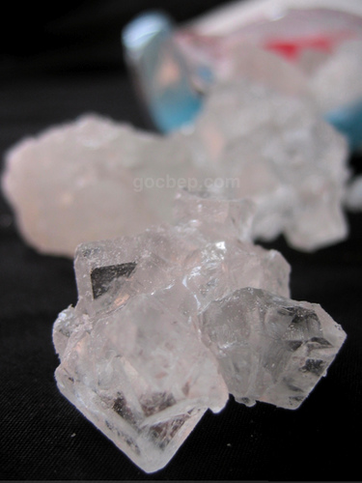
Rock Sugar
Large sugar crystals made by crystallizing a supersaturated sucrose solution around a large nucleon site, such as a string to produce chunky crystals
5 mm in length

Slide 12
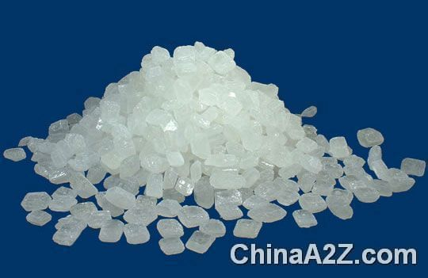
Crystal Sugar
Large crystals about 4 times the size of granulated sugar
Used for decorating confections and baked goods.
2 mm in length

Slide 13
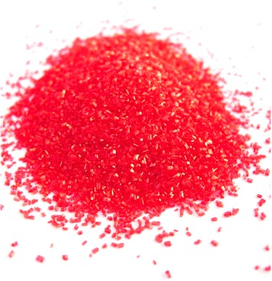
Sanding Sugar
Large crystals, washed with alcohol to remove dust
Used for making super clear syrups and perfectly white icings
Commonly sprinkled on cookies and doughnuts
1 mm in length

Slide 14
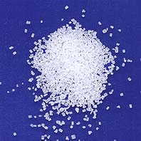
Preserving Sugar
Large crystals made from highly refined sugar treated to dissolve easily
Used for making jams, jellies, and preserves
1 mm in length

Slide 15
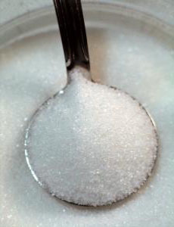
Granulated Sugar
Medium sized
An all-purpose sugar
0.5 mm in length

Slide 16
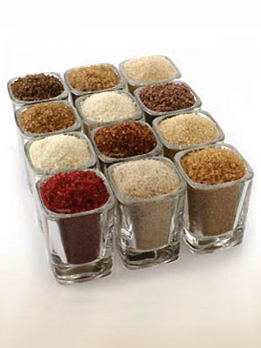
Colored and Flavored Sugar
Crystal or granulated sugar that is colored with food coloring and flavored with ground spices, flower petals, or citrus zest or infused with aromatic oils from cinnamon and vanilla
Used to decorate and flavor confections, baked goods and beverages

Slide 17
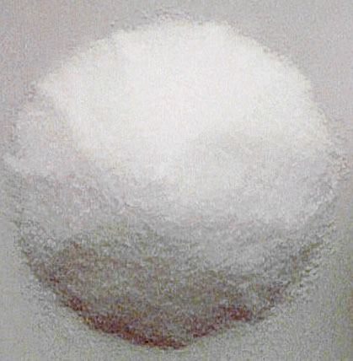
Superfine Sugar
Finely ground granulated sugar for smooth mouth feel
0.1 mm in length

Slide 18
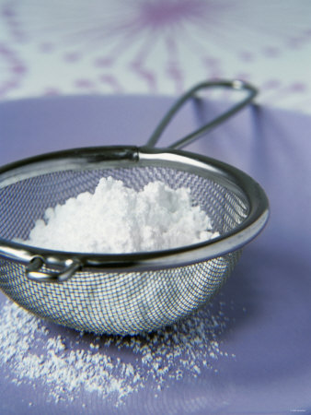
Confectioner Sugar
Very finely crushed granulated sugar, mixed with about 3% starch to prevent clumping
0.01 mm in length

Slide 19
Brown Sugars
Can be raw or refined crystals that are coated with some of the dark syrup that is extracted during processing (from least refined to most)
Demerara Sugar
Muscovado Sugar
Sucanat Sugar
Turbinado Sugar
Brown Sugar

Slide 20
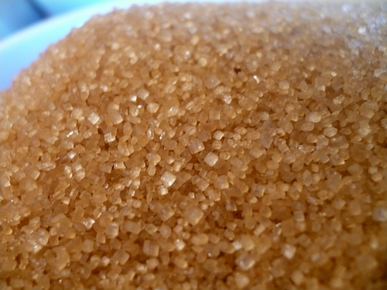
Demerara Sugar
Sugar crystals taken from the first crystallization of light cane juice
The crystals are large, golden and slightly cracked

Slide 21
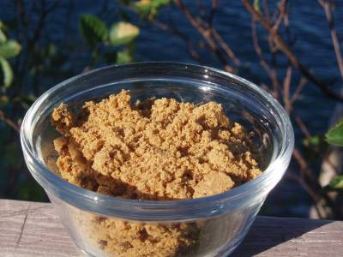
Muscovado Sugar
Sugar crystals taken from the final crystallization of cane syrup into blackstrap molasses
The crystals are dark brown, small, strongly flavored and sticky

Slide 22
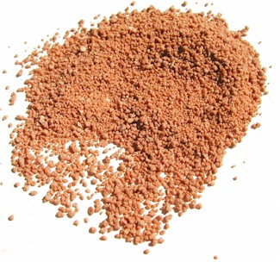
Sucanat
A trademark raw sugar made by evaporating juices to create a granular rather than a crystalline texture

Slide 23
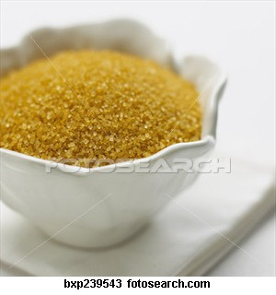
Turbinado Sugar
Demerara sugar washed of some of its molasses so it’s not sticky.

Slide 24
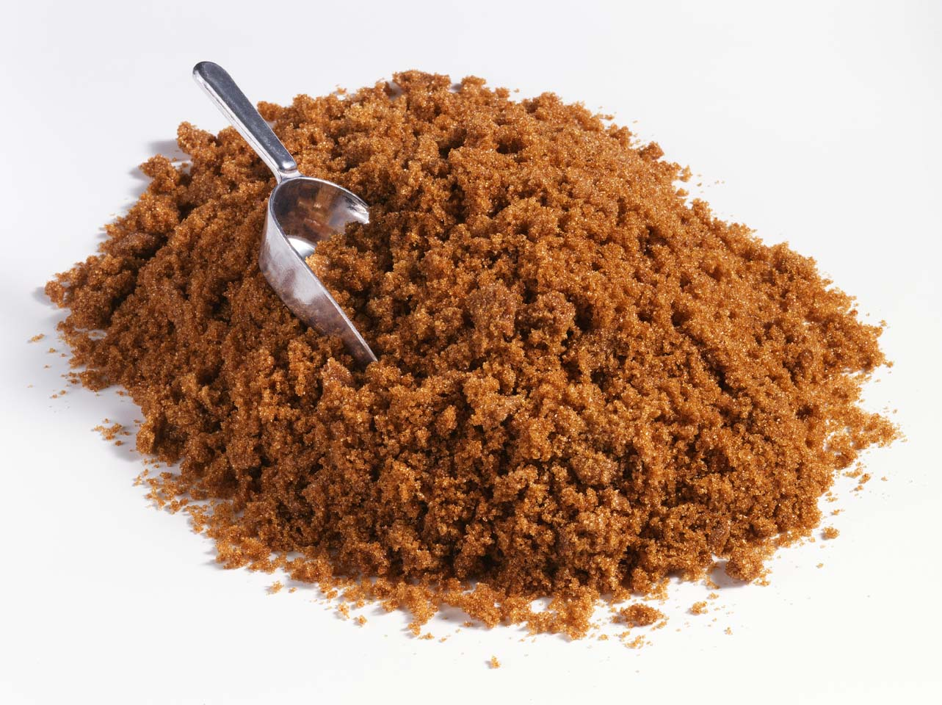
Brown Sugar
Refined white sugar that is either soaked in molasses syrup and recrystallized or thinly coated with molasses. The more molasses the darker the sugar.

Slide 25
Refined Sugar from other Plants
Palm Sugar
Stachyose Sugar
Crystallized from sugar palm sap
It can be unrefined or refined
A complex sugar derived from any one of numerous vegetables, mostly legumes.
It is about a quarter as sweet as sucrose and has some thickening abilities.
It is mostly used industrially as a bulk sweetener.

Slide 26
What It Does
In baking:
Sugar impedes to coagulation of proteins, tenderizing doughs and pastries by interfering with gluten formation,
It protects custard and pastry cream from curdling
Sugar is both hydroscopic and hydrophilic resulting in moist baked goods
Hydroscopic - it absorbs water from its environment
Hydrophilic - it bonds with water and holds on to it
Example: the hydrophilic quality of molasses is also what makes brown sugar moist – brown sugar will dry out and become hard when exposed to air – by wrapping it in a damp towel it will soften up right away

