Slide 1
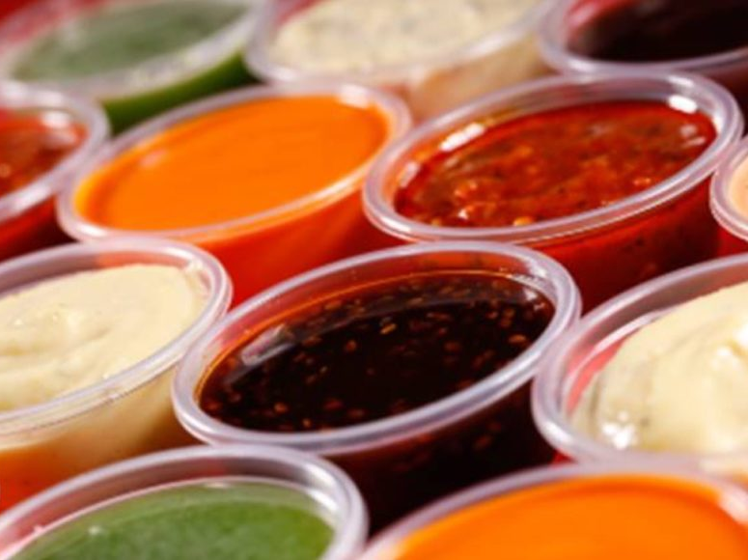
Sauces

Slide 2
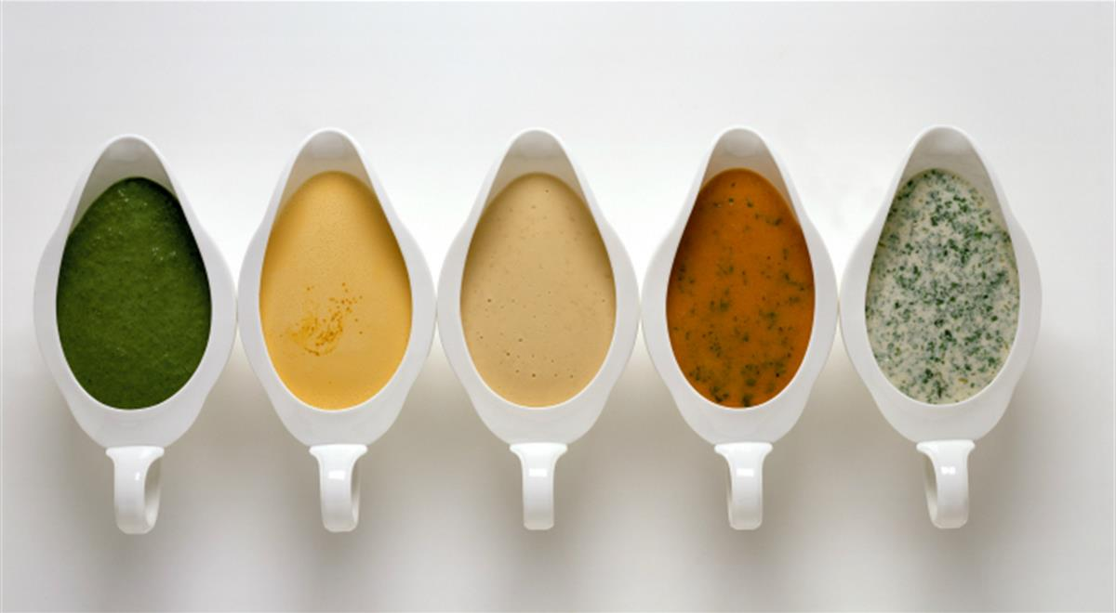
What It Does
Confronted with a hunk of food that’s been simply sautéed, roasted, or poached, most serious cooks want more: a flavorful nudge, a textural counterpoint, a sauce to turn what is basically nutritious into something delicious

Slide 3
What It Does
The word “sauce” comes from the Latin word for salt, sal, making a concoction between the presence of a sauce and our ability to savor what we eat
The earliest sauces were just seasoned cooking juices, and may have included natural fruit juices or honeys
It wasn’t long before fermented liquids were used to create the first wine and condiment sauces, including vinegars, soy sauces, and fish sauces

Slide 4
What It Does
All of these sauces heighten flavor, but they do it with a thin, watery liquid
For a sauce to deliver its maximum flavor potential, it must be thickened to allow it to linger on the food and in the mouth

Slide 5
Thickening A Sauce
Flavorful liquids consist mostly of water containing suspended flavorful particles
To thicken
Reduce the amount of liquid
Increase the amount of solids
Reduction – boiling the liquid until the solid particles suspended in it concentrate and thicken the resulting sauce

Slide 6
Thickening a Sauce
Adding solids
Mixing in a cooked puree of fruit or vegetable, which will increase a sauce’s nutrition, flavor, color, and viscosity
Adding a small amount of carbohydrate, usually a starch or gum that has the ability to absorb liquid many times it volume
To keep sauces from lumping, carb thickeners have to be suspended in water (a slurry) or fat (a roux) before incorporated into a sauce

Slide 7
Thickening A Sauce
Emulsion or protein thickened sauces disperse fat droplets and/or protein particles in liquid rather than use a carb for thickening
Because water bonds with starches and gums better than with proteins and fat, emulsion and protein-thickened sauces tend to be less stable

Slide 8
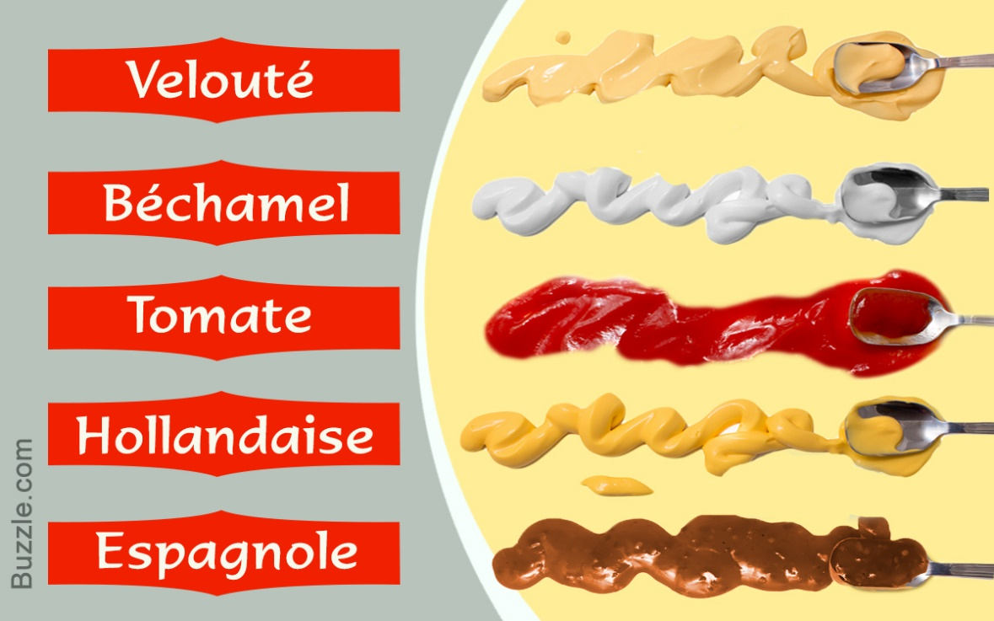
History
The French are considered the creators of classical sauces and records can be dated back to the 15th century
Antonin Carême (1784-1833) who, seeking to simplify the excesses of cuisine that were popular before the French Revolution, created a family tree of sauces
Grouped according to their liquid ingredient, their method of thickening and their seasoning

Slide 9
Classic French Sauces
Espangole
Liquid – brown Stock
Thickener – brown roux
Flavoring – browned meat, browned carrot, celery, onion; tomatoes, spices
Velouté
Liquid – veal or chicken Stock
Thickener – blonde roux
Flavoring – blanched meat, carrot, celery, onion, spices

Slide 10
Classic French Sauces
Bechamél
Liquid – milk
Thickener – white roux
Flavoring – carrot, celery, onion, spices
Hollandaise/Mayonnaise
Liquid – lemon juice or vinegar
Thickener – butter/oil emulsified with egg yolk
Flavoring – lemon, vinegar

Slide 11
Classic French Sauces
Tomato
Liquid – tomatoes and stock
Thickener – tomato purée
Flavoring – carrot, celery, onion, herbs

Slide 12
Sauces and Cultures
Chinese
Cooking liquids through braising or stir-frying, then seasoned and thickened with condiments like soy sauce, hoisin sauce, black bean sauce, and oyster sauce
Latin American
Elaborate stews of chiles that are thickened with ground nuts and fruits (moles
Quick raw salsas of chopped vegetables and fruits

Slide 13
Sauces and Cultures
Indian
Long-simmered curries
Quickly prepared raw salads and yogurt sauces

Slide 14
Italian Sauces
Pulpy sauces made mostly from tomatoes
Pan sauces made from the drippings that glaze the surface of a pan after sautéing or roasting
Two types of Italian tomato sauces:
All vegetable – usually a combination of onions , tomatoes and garlic, seasoned and simmered just until the vegetables are soft
Vegetables and Meat – cooked for hours with a soffritto (diced carrots, celery, onions) until the meat and veggies collapse into one another – known as a ragù

Slide 15
Italian Sauces
Italian pan sauces can be made only in conjunction with the preparation of the meat or fish they accompany
Made by dissolving the pan drippings with wine, stock, or fruit juice and reducing the liquid – they must be served right away

Slide 16
Roux
An equal mixture of flour and melted fat
Before the 17th century, sauces were thickened with proteins, such as blood or egg yolks

Slide 17
Roux – How It Works
Flour is a mixture of starch and protein. When it is stirred directly into hot broth, its surface starch takes in water on contact, expands, and traps bits of dry flour in a casing of gelitinized starch – in other words, it forms a lump
Combine the flour with fat before it contacts the liquid, seperates the flour particles from each other, so when added to water the flour particles absorb the liquid individually and can’t stick together

Slide 18
Classifications of Roux
Roux is started by melting fat over heat no higher than medium, because the fine grains of flour scorch easily.
The flour is stirred in to combine the fat, then cooked to varying degrees:
White Roux – (for bechamèl) cooked for about 3 minutes, just until it no longer smells of uncooked flour and before the flour colors

Slide 19
Classifications of Roux
Blonde Roux – (for velouté) cooks for 4-6 minutes , until it starts to smell like toasted nuts and turns golden to tan
Brown Roux – (for espagnole) cools for 7-15 minutes, until it smells like toast and browns. Be careful not to splash; brown roux is very hot!

Slide 20
Gravies
Beef gravy is akin to espagnole sauce, and chicken gravy is similar to velouté
The main difference is that gravies are made directly from the drippings of a roast whereas the mother sauces are made independently of the food
To make gravy
Flour is mixed into the drippings, and then water, milk, or stocks are stirred in until the sauce is thickened

Slide 21
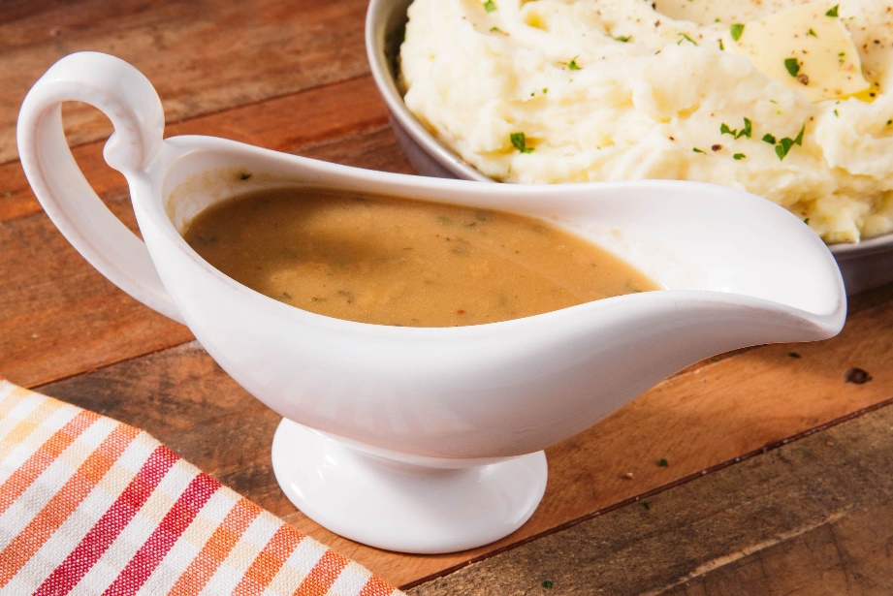
How It Works
The flavor of the sauce develops from an interplay of liquid, seasoning, and thickener
Seasonings need to be assertive
Stocks and broths for sauce making need to be full flavored
If they are not, reduce them to concentrate their flavorful parts
To ensure full flavored meat sauces, use demi-glace (brown stock reduced to 1/3 volume)

Slide 22
How It Works
Thickeners, especially starchy thickeners, diminish flavor
Completely watery sauces taste bland because they lack the viscosity to stay on the plate long enough to be tasted
As long as a sauce is thick enough to coat a surface, the thicker it is, generally the more flavor it will have

Slide 23
How It Works
All liquids are predominantly water and thickeners work by limiting the movement of water in a liquid.
When particles are dispersed in a liquid, they interfere with the movement of water molecules, and the liquid becomes more solid
Coarse particles, like chopped vegetables in a salsa or a chunky tomato sauce, won’t interfere much with water flow, resulting in a watery sauce
Puree the vegetables, though, and the sauce will immediately get thicker

