Slide 1
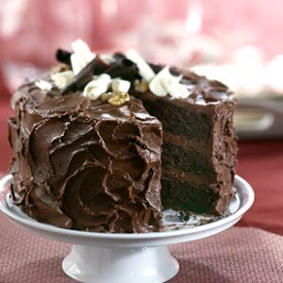
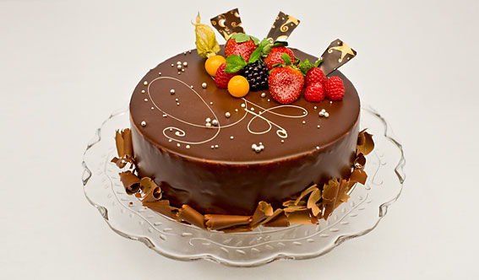
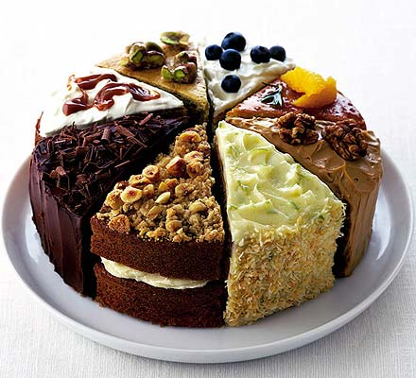
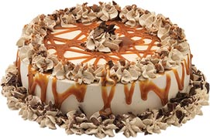
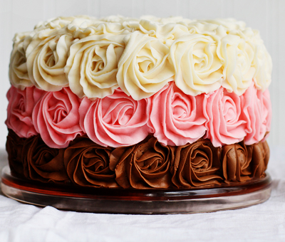
Cakes

Slide 2
Cake Ingredients
Cake ingredients either weaken or strengthen a cakes structure and determine its texture, moisture, and sweetness.
I.e., When sugar and fat are used in the right amounts, a cakes structure can weaken and be more tender – on the other hand – eggs and flour both have proteins that, when they are baked, join together to give the cake support

Slide 3
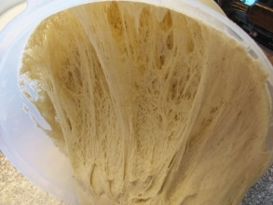
Cake Ingredients
The starch in flour also help stabilize, or support, the cake by absorbing liquid when it is mixed.
Liquids form gluten when they combine with flour and when mixed, this gluten give structural support to the cake

Slide 4
High-Fat Cakes
Leavening agent – Baking powder
High-fat cakes require that the air cells be creamed into the center of the fat cell.
The air cells then pick up the leavening gases that the heat of the oven releases

Slide 5
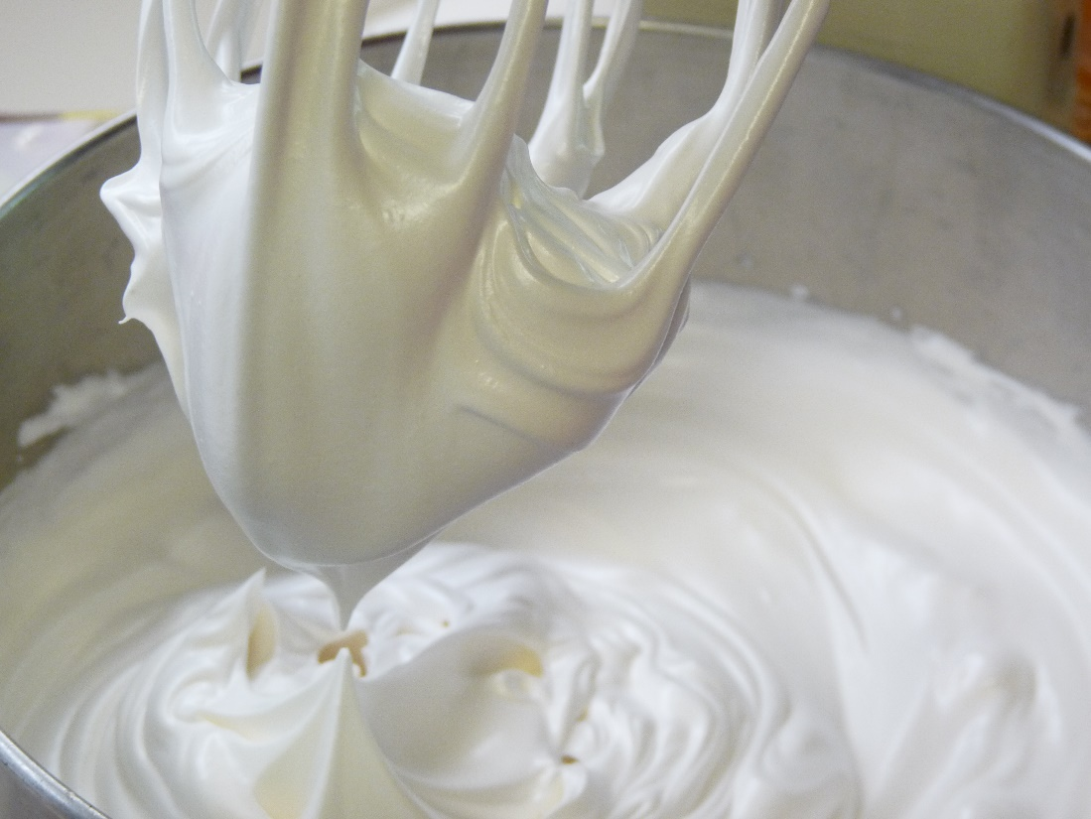
Low-Fat Cakes
Leavening agent – air
Air is whipped into the egg batter, giving these cakes a light and springy texture

Slide 6
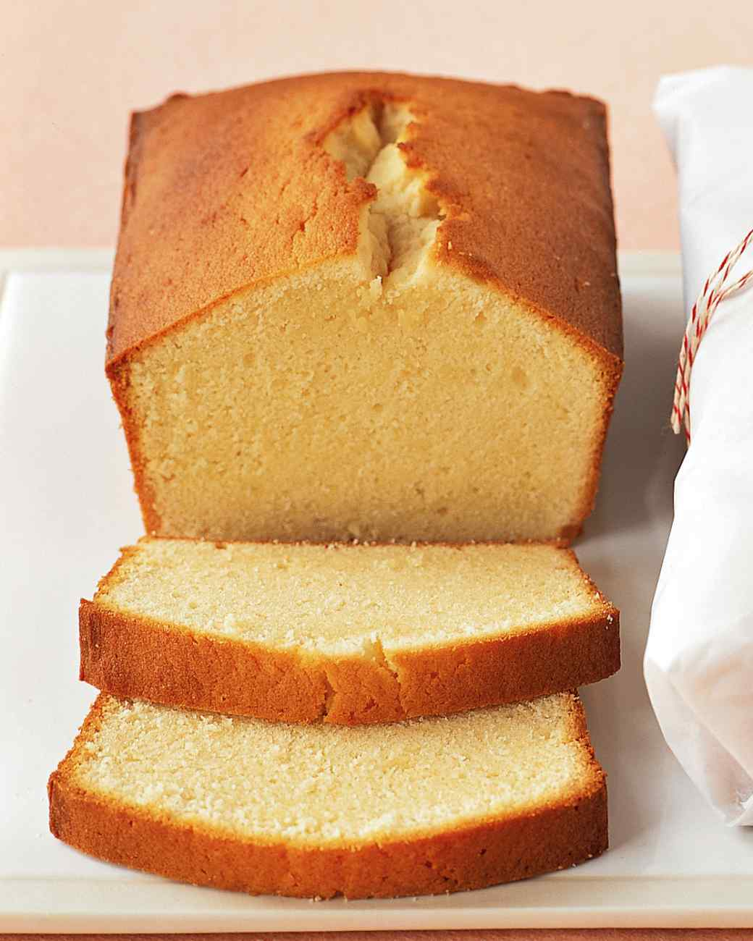
Pound Cakes
Origin is traced back to England
Contains 1 pound of each flour, butter, sugar, and eggs and are flavored with vanilla, almond or lemon
A pound cake is considered the basis for all layer cakes
It can be frozen up to 2 months and kept in the fridge for 1 week.

Slide 7
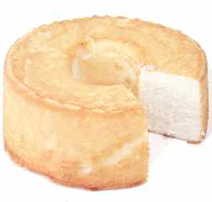
Sponge or Foam Cakes
This cake has an airy, light texture because of large amounts of air whipped into the eggs.
It does not rely on butter or fat to hold onto air, instead, these cakes have a base of whipped whole eggs
European sponge cakes, called genoise, is a common example of a sponge cake layered with jam, chocolate or fruit filling

Slide 8
Angel Food Cake
An angel food cake is a foam cake that is made with egg whites, but not egg yolks.
The air is whipped into the egg whites and leavens the cake
Once the eggs have been whipped, the cake batter must be finished quickly, or it will collapse when the air beaten into the eggs escapes
Baked in a tube pan that is ungreased, the batter literally climbs up the side of the pan
When finished baking, turn the pan upside down to prevent the cake from falling
It can be served plain or with fruit and fillings and is a healthful alternative because of its low-fat content

Slide 9
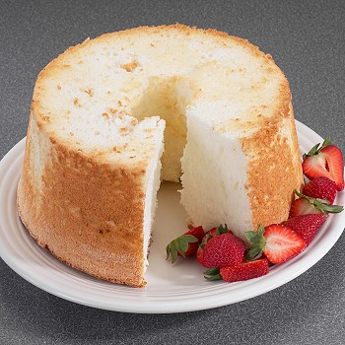
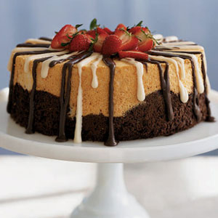
Angel Food Cake

Slide 10
Chiffon Cakes
A chiffon is a variation of a genoise cake
Made by using whipped egg whites to lighten the batter
The egg yolk and part of the sugar are whipped to full volume and then the flour is added to the yolk and sugar mixture
The egg whites and the remaining sugar are whipped and then folded in

Slide 11
Chiffon Cakes
Chiffon cakes have less saturated fat and cholesterol than any cake except for angel food cake, and about half the fat of a pound cake.
Like angel food cakes, chiffon cakes are cooled upside down

Slide 12
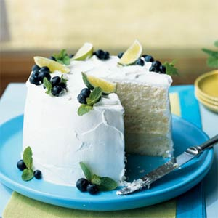
Chiffon Cakes

Slide 13
Baking Cakes – Prep Methods
To keep cakes from sticking, baking pans are usually coated with fat and flour or lined with parchment paper.
This allows the cake to release easily from the pan after baking is done
Pans should be filled one-half to two-thirds full – this will keep the batter from spilling over the sides of the pan as it rises.

Slide 14
Pan Preparation
It is important that the pans be prepared before the batter is mixed so that air cells in the batter do not collapse
If greasing and dusting with flour, extra flour should be tapped out of the pan so the bottom of the cake doesn’t become doughy
Using parchment paper will prevent your cake from sticking as well, and after its done cooling, you can just peel it off.

Slide 15
Baking Techniques
Preheat the oven to the correct temperature
If the oven is too hot – the cake may set before it is fully risen and your crust will become very dark
If the oven is too low – the cake will not set fast enough and the cake could collapse

Slide 16
Baking Techniques
Ovens and shelves should be even.
When pans are placed in the oven, they should not touch as air needs to flow between the pans for even baking
Top Shelf
Bottom Shelf

Slide 17
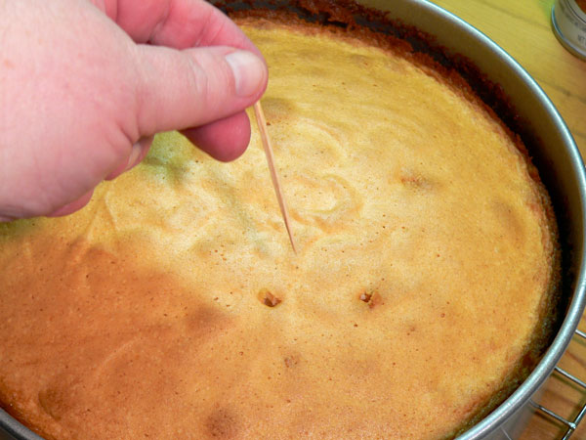
Determining Doneness
A cake is done when:
A pick or cake tester comes out clean when it is inserted into the center
The center of the cake’s top springs back when it is lightly pressed
The cake pulls away slightly from the sides of the pan

Slide 18
Cooling Cakes
High-Fat Cakes
Foam Cakes
Always cool cakes for at least 15 minutes before you remove them from the pan
Because you cake is still setting when it comes out of the oven, waiting to remove it won’t result in a broken cake
If using parchment paper, peel it off the cake
Cool upside down to preserve the structure of the cake
Once completely cooled, loosen the cake using a spatula
Put a cooling rack or tray on top of the cake and turn it over. Remove cake from the pan.

Slide 19
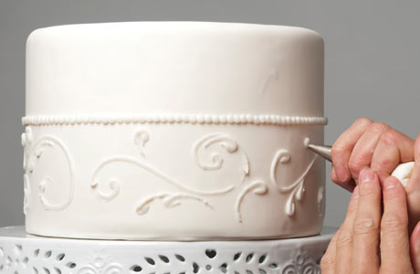
Icing
Icing improves a cake by forming a protective layer around the cake that seals in moisture
It adds richness and flavor
It makes it look attractive

Slide 20
Icing Cakes
The main thing when considering icings is to be sure the icing is not too heavy for the type of cake.
Dense cakes pair well with heavy icing like German Buttercream (Made with butter, shortening and fondant)
Lighter cakes pair well with light icings like Swiss buttercreams (buttercream folded with meringue and butter)

Slide 21
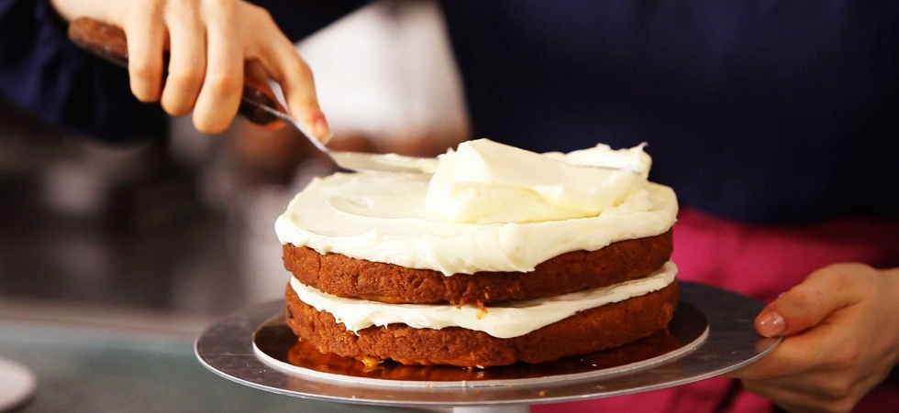
Icing Cakes
Before icing, tap off any loose crumbs
Have all fillings prepared
To ice a cake:
Place a good amount of icing on top in the center of the cake and work the icing around the top from side to side
Spread the icing down the sides of the cake
Smooth the surface of the icing before adding decorations

Slide 22
Cake Storage
Wrap a cake in an air-tight container or plastic wrap and store in the fridge
Be careful, as frostings will easily absorb refrigerator odors
Always bring cakes to room temperature before you serve them

Slide 23
All pages should now be done! TODAY – Finish & Complete… Page #25 – Baking Review Questions
we Have not yet completed [these pages will be blank – save for next time]
Page 8 (Definitions)
Page 11-12 (Career Profile)
Page #27 - Leavening Agents

